Slide 1
Milestone 2
Wong Yao Hui - 1901868
Ng Jing Kiat - 1901819
Marsius - 1901855

Slide 2
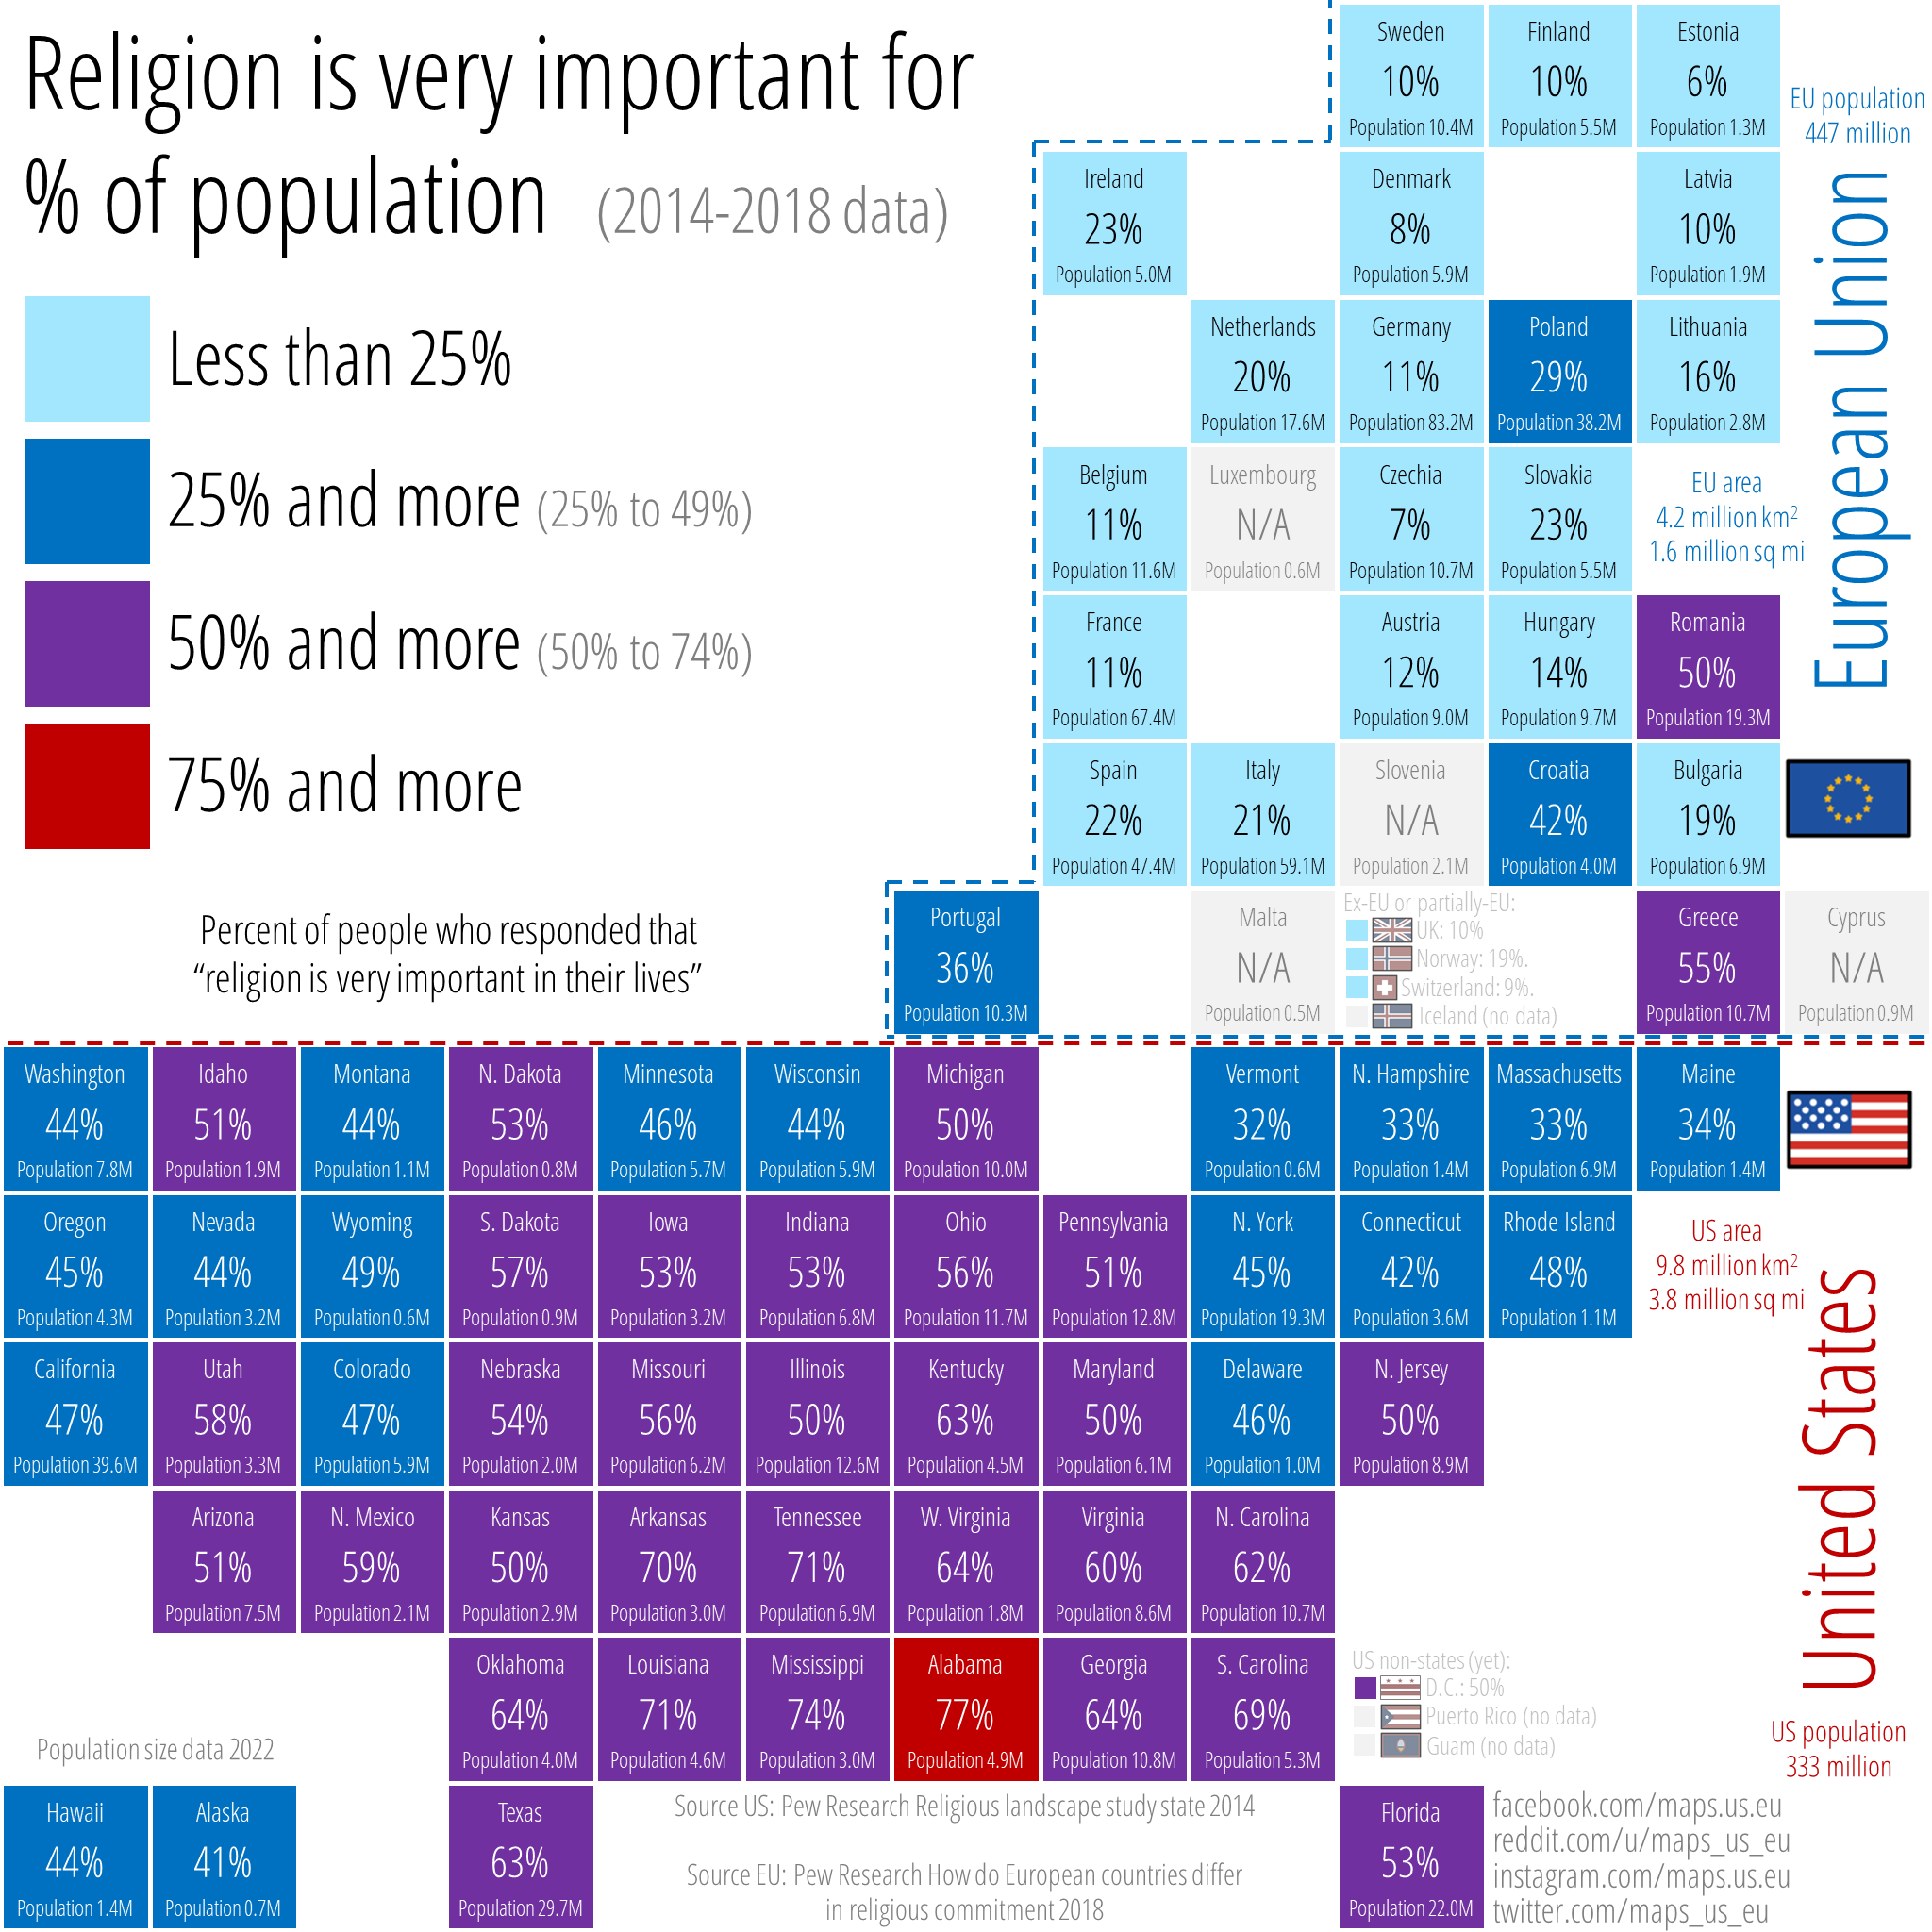
Chosen visualization
This graph is designed by user, maps_us_eu, to visualize the importance of religion for the population between the United States and European Union.
Source: https://www.reddit.com/r/dataisbeautiful/comments/vfrqow/percent_of_people_who_responded_that_religion_is/

Slide 3
Milestone 2 Demo

Slide 4
Milestone 2: Data (What)
Our dataset consist of the Population for EU and US, and the Religion Importance % for the US states and EU countries.
Quantitative data: Population and religion importance %
Qualitative data: States/Countries
Notes:
What (data): What is the data about
Not sure to include:
The population data should be excluded or represented in a different graph as it does not fit well with the percentages shown.
Eg. California 47% (39.6M) vs Alabama 77% (4.9M)

Slide 5
Milestone 2: Task (Why)
The visualization is to show the importance of religion for each state/countries of the US or EU to allow users to analyze in which state/countries where the population consider religion to be of importance or not important.
Notes:
What (data): What is the data about
Not sure to include:
The population data should be excluded or represented in a different graph as it does not fit well with the percentages shown.
Eg. California 47% (39.6M) vs Alabama 77% (4.9M)

Slide 6
Milestone 2: Idiom (How)
The idiom is a choropleth map. The first tab is the map showing the different states in the United States (US). The second tab is the map showing the different countries in the European Union (EU). The third tab has both the US and EU maps side-by-side, for comparison of the data.
The percentage of religious population in each states of the US and each countries of the EU are represented by two colours of different gradient.
0% - 50%: Dark Blue - Light blue
50% - 100%: Light Red - Dark red
Notes:
0% - 50%: Dark Blue - Light blue
50% - 100%: Light Red - Dark red
Using a default light to dark gradient does not visualize the difference well as the light gradient blend into the leaflet map making it difficult to see. Hence using dark colour for both end of the range spectrum helps to visualize the difference more distinctly.

Slide 7
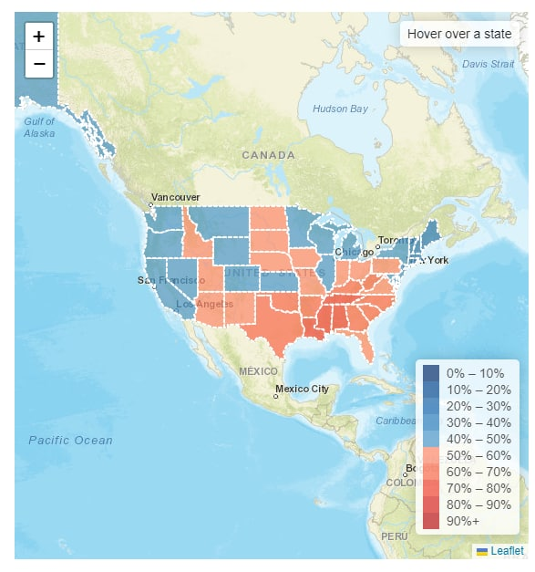
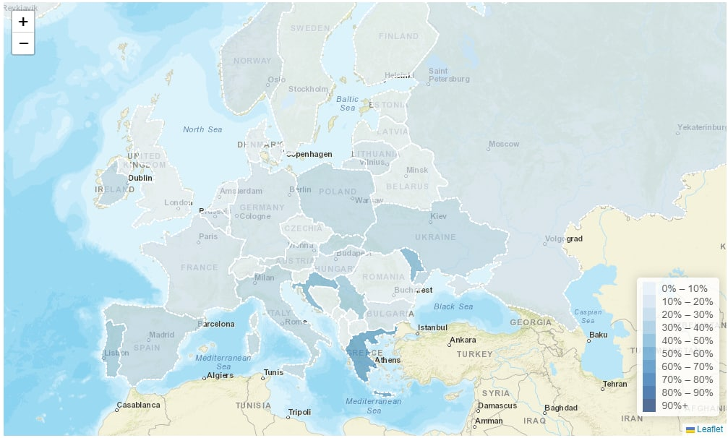
Milestone 2: Idiom (How)
Using a default light to dark gradient does not helps the user to visualize the difference well as the light gradient blend into the leaflet map making it difficult to see. Hence, using dark colour for both end of the range spectrum helps to visualize the difference more distinctly.
Notes:
0% - 50%: Dark Blue - Light blue
50% - 100%: Light Red - Dark red
Using a default light to dark gradient does not visualize the difference well as the light gradient blend into the leaflet map making it difficult to see. Hence using dark colour for both end of the range spectrum helps to visualize the difference more distinctly.

Slide 8
Design Principle
Brief Overview:
Gradient of colour in the map shows the states/countries with lower/higher religious population
Zoom:
Zoom in/out for more details on the states/countries
Legend:
Distinguish between high/low importance of religion
Tooltip:
Display additional information on mouse hover
Notes:
https://medium.com/gobeyond-ai/7-key-principles-of-effective-data-visualization-b854b0b81946

Slide 9
Pitfalls
Dataset is of different years where US is 2014 and EU is 2018
EU Dataset for importance of religion does not contain sample size count
Initially, tried SVG for the comparison of both map but decided that Leaflet is more consistent in visualization flow.

Slide 10
Technologies used
Leaflet
Bootstrap 5
D3 Js
Jquery

Slide 11
Team member contribution
Wong Yao Hui | Data Preprocessing Leaflet template map for US, EU SVG Map (Not implemented) Integration Presentation/Documentation
Ng Jing Kiat | Data Preprocessing Leaflet choropleth map Leaflet Legend + highlight Integration Presentation/Documentation
Marsius | Data Preprocessing Leaflet Tooltip Integration Presentation/Documentation

Slide 12
Future Work
Resolve the tooltip bug when highlighting comparing map.

Slide 13
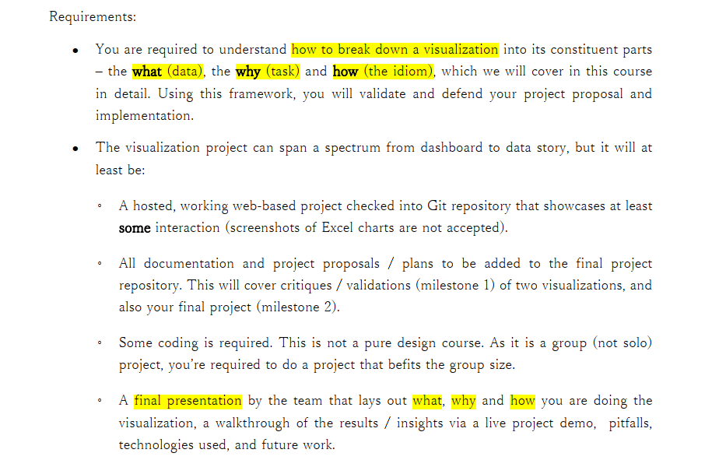

Slide 14


Slide 15
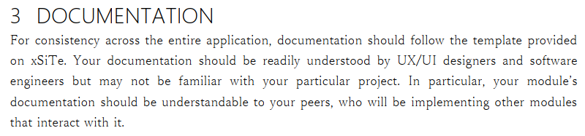

Slide 16
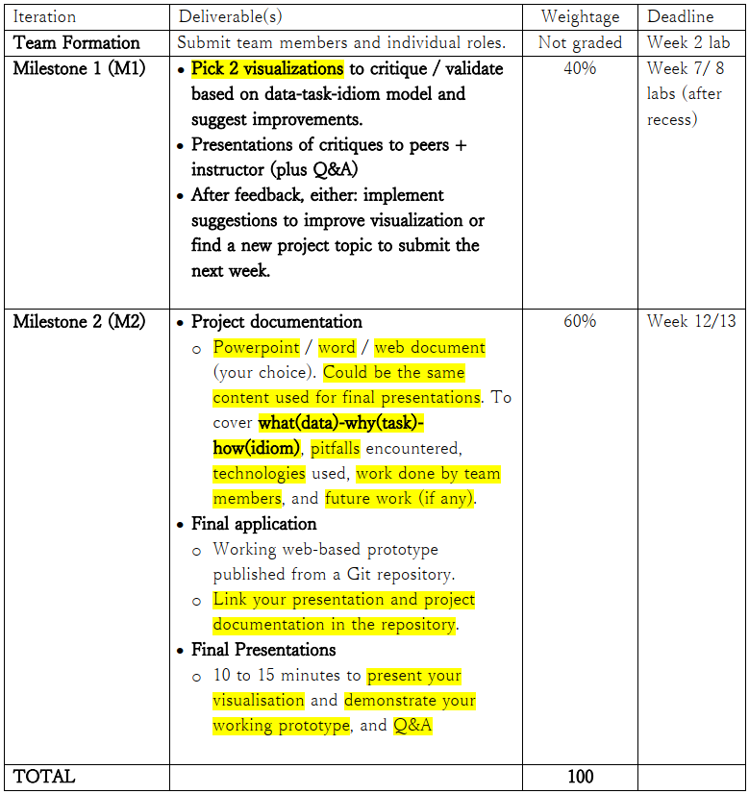

Slide 17
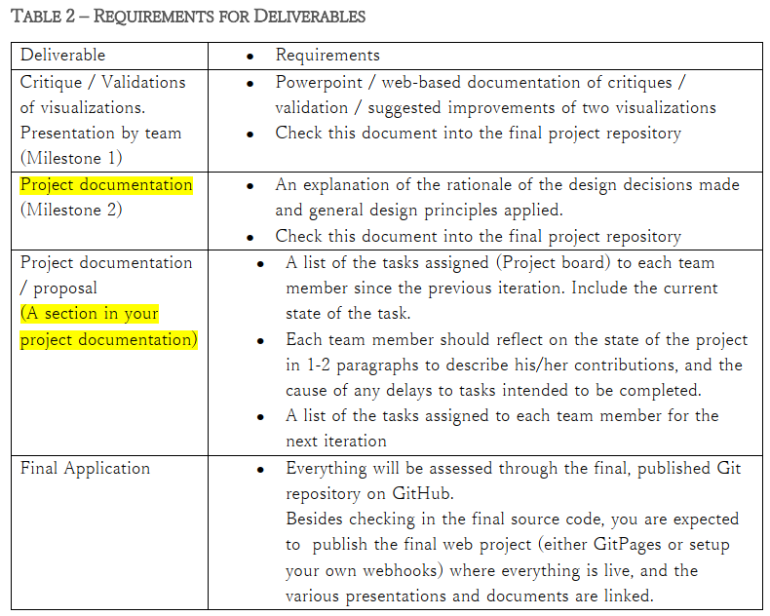

Slide 18


